Slide 1


DEPARTMENT OF ARTIFICIAL INTELLIGENCE AND MACHINE LEANING
FOODWISE AI: AGENTIC AI FOOD WASTE PREDICTION AND PREVENTION SYSTEM
Team Members
Meghna Rajesh Mellam - 231501098
Princess Darlene Karonah – 231501123
Vishal M - 231501184

Slide 2

Problem Statement
1
Food Demand Is Difficult to Estimate Reliably
Food Waste Prediction & Prevention
Cafeterias and restaurants often over-prepare food because demand is difficult to predict accurately. This results in food waste, higher costs, and inefficient resource usage. FoodWise AI uses ML-based demand prediction and an Agentic AI decision layer to recommend optimal preparation quantities and continuously improve decisions using actual sales and leftover data.
Demand Prediction
Optimal Preparation
Waste Monitoring
Continuous Improvement
Final review
Department of Artificial Intelligence and Machine Learning

Slide 3
Proposed System: Analysis Pipeline
2
Combines demand forecasting, adaptive decision-making, feedback, and explainable analytics in one modular system.
Demand Data | Historical sales, weekday/weekend, food category and recent consumption patterns.
ML Forecast | Random Forest predicts expected servings for the selected food item and date.
Context Retrieval – Retrieve recent waste, prediction errors and contextual information.
Agent Decision | Adjusts the preparation quantity using waste rate, recent error, weather and events.
1
2
3
4
Preparation Plan | Converts prediction into an actionable quantity for kitchen staff.
5
Actual Outcome | Sales and leftovers are recorded after service.
6
Feedback Loop | Prediction error and waste trends update future recommendations.
Final review
Department of Artificial Intelligence and Machine Learning

Slide 4
Proposed System: Data Sources
3
Historical demand, operational records, and contextual signals support every recommendation.
Historical Sales Data
Food item
Date
Quantity sold
Day of week
Food Waste Records
Leftover quantity
Waste percentage
Previous over-preparation
Food Metadata
Food category
Serving capacity
Preparation constraints
Context Data
Weather/temperature
Holidays
Special events
Weekend/weekday
KEY ARCHITECTURAL HIGHLIGHT | Numerical prediction stays separate from the agent decision layer; the agent explains and adjusts rather than inventing demand values.
Final review
Department of Artificial Intelligence and Machine Learning

Slide 5
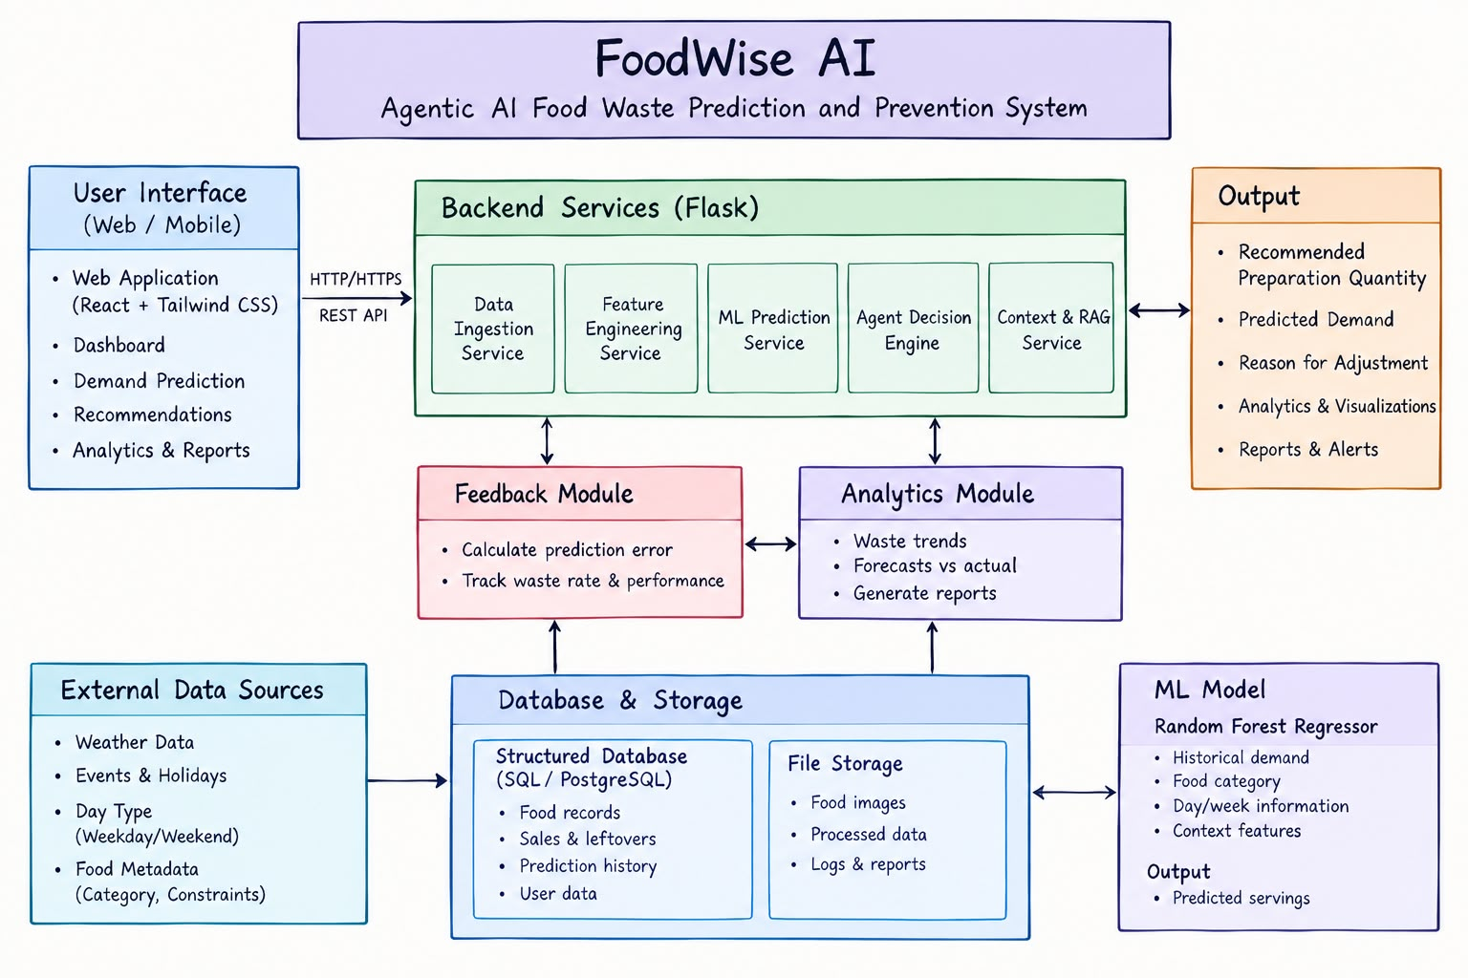
System Architecture: Tiered View
4
ML Demand Forecast
Evidence Retrieval
Agent Decision Engine
Recommendation: Prepare 158 servings
Example: forecast 180, recent waste + weekend context
Feedback: actual demand + leftovers → prediction error → future recommendations
Final review
Department of Artificial Intelligence and Machine Learning

Slide 6
Backend Modules
5
Seven backend modules keep prediction, decision-making, feedback and analytics concerns separate.
1
Data Ingestion | CSV / form input / cafeteria records
2
Feature Builder
lag demand • weekday • category • weather
3
ML Predictor
Random Forest Regressor
4
Agent Engine
bias + waste + context + rules
5
Feedback |
actual sales • leftovers • prediction error
6
Analytics |
trends • waste rate • savings indicators
7
API & Database | Flask • SQLite / PostgreSQL
8
Model Monitor | drift and performance checks
Final review
Department of Artificial Intelligence and Machine Learning

Slide 7
Module: Machine Learning Model
6
Model evaluation is reported on a chronological synthetic prototype dataset.
METRIC 01
MAE
10.64 servings
METRIC 02
RMSE
13.34 servings
METRIC 03
R²
0.824
METRIC 04
Test Split
20% chronological holdout
METRIC 05
Observations
2,912 usable rows
Final review
Department of Artificial Intelligence and Data Machine Learning

Slide 8
Module: Agent Safety & Operational Scope
7
Core Guarantee: the agent never replaces the ML forecast; it makes a transparent operational decision from the forecast plus evidence.
1
Forecast First | Baseline demand from ML
2
Risk Check | Recent waste + bias
3
Context Check | Weekend + weather + events
4
Preparation Plan | Adjusted quantity within limits
5
Explanation | Show why the quantity changed
FoodWise AI is a decision-support system for restaurants, cafeterias, canteens and other food-service businesses. It does not autonomously control kitchen operations..
Safety & Operational Guarantee | ✓ No hidden overrides of the model | ✓ Evidence-based adjustment | ✓ Human review remains available | ✓ Prototype results are clearly labelled as synthetic
Final review
Department of Artificial Intelligence and Machine Learning

Slide 9
Module: Agentic RAG / Context Retrieval
8
The optional RAG layer grounds agent explanations in retrieved cafeteria evidence and operating rules.
Example Agent Retrievals
Architecture Flow
"Why is today’s recommendation below the forecast?" | Retrieves recent waste rate and prediction-bias records
Current Forecast | Predicted servings
Context Retrieval | Recent records + rules
"What happened to this food item recently?" | Retrieves recent demand, leftovers and feedback history
Evidence Selection | Relevant signals only
Decision | Adjusted preparation quantity
Key Capability: Retrieved context explains the decision; the numerical forecast remains the source of the baseline demand value.
Cited Explanation | Evidence + recommendation
Dashboard | Agent activity + rationale
Forecast → Retrieval → Decision → Explanation → Feedback
Final review
Department of Artificial Intelligence and Machine Learning

Slide 10
Implementation Progress: Execution Flow
9
Linear sequence from historical records to an actionable, feedback-aware preparation plan.
01
Historical Data | Load sales and leftover records
06
Kitchen Action | Prepare recommended quantity
02
Feature Engineering | Create lag, calendar and context features
07
Outcome Capture | Record sales and leftovers
03
ML Prediction | Forecast expected servings
08
Feedback Analysis | Calculate prediction error and waste rate
04
Context Retrieval | Fetch waste, bias and operating signals
09
Model/Rule Update | Refresh future decision inputs
05
Agent Decision | Calculate preparation recommendation
10
Dashboard | Show forecast, recommendation and impact
Final review
Department of Artificial Intelligence and Machine Learning

Slide 11
Implementation Progress: Tech Stack
10
Built with React, Python Flask, Pandas, NumPy, scikit-learn and a relational database.
FRONTEND | React | Tailwind / Bootstrap | Recharts or Chart.js
BACKEND | Python | Flask REST API
MACHINE LEARNING | Pandas | NumPy | scikit-learn | Random Forest Regressor
DATA & STORAGE | SQLite prototype | PostgreSQL/MySQL production | CSV import
AGENT & RAG | Rule-based decision engine | Optional retrieval over structured cafeteria history
DEPLOYMENT | Hostinger VPS | Gunicorn + Nginx | Optional Docker
WEB APPLICATION | Dashboard, Prediction, Food Records, Agent Activity, Analytics, Feedback and Admin modules.
CORE PAGES | Dashboard, Demand Prediction, Food Records, Feedback
ANALYSIS VIEWS | Forecast vs Actual, Waste Trends, Agent Rationale
DATA LAYER | Database + historical CSV / operational records
Final review
Department of Artificial Intelligence and Machine Learning

Slide 12
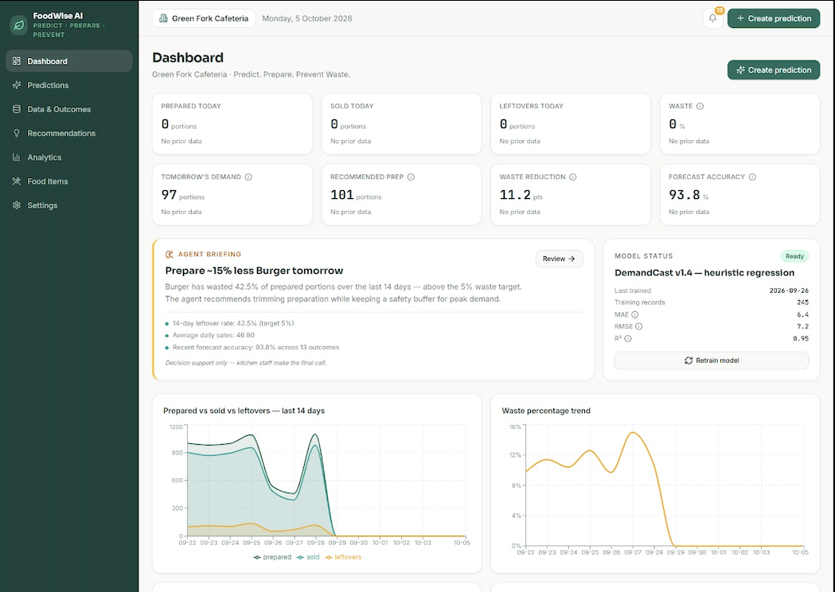
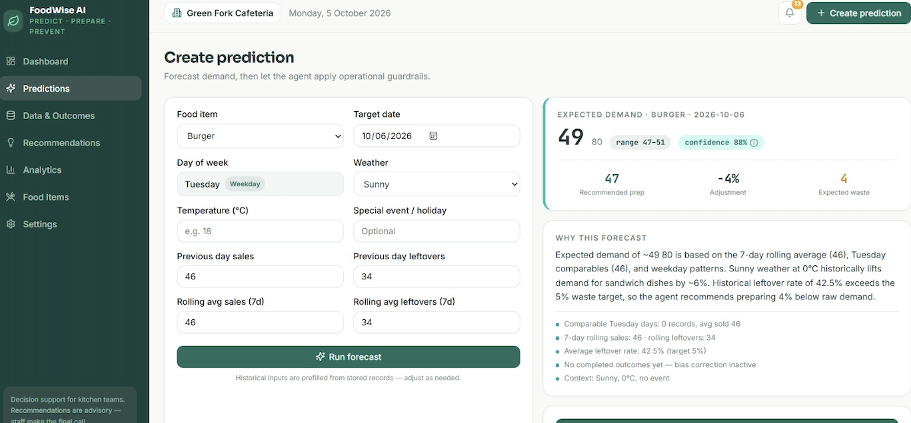
Outputs/Results
11
Dashboard
[Insert actual website screenshot]
Demand Prediction
[Insert actual website screenshot]
Agent Recommendation
[Insert actual website screenshot]
Analytics & Waste
[Insert actual website screenshot]
Final review
Department of Artificial Intelligence and Machine Learning

Slide 13
Overall Project Progress
12
EXPERIMENTAL EVALUATION | Prototype Results
FUTURE PATHWAYS | Planned Enhancements
Random Forest Forecasting | MAE 10.64 servings; RMSE 13.34 servings; R² 0.824 on a chronological synthetic test split.
Real Cafeteria Data | Replace synthetic records with actual daily sales and leftover measurements.
Live Context Signals | Integrate weather, events and menu schedules where available.
Adaptive Agent | Simulated policy reduced over-preparation by approximately 62.3% versus a fixed 10% buffer under the generated prototype data.
Advanced Models | Compare Gradient Boosting, XGBoost and time-series approaches.
Feedback Loop | Recent prediction bias and waste rate are used to adjust future preparation recommendations.
Production Deployment | PostgreSQL, authentication, monitoring and role-based kitchen access.
Final review
Department of Artificial Intelligence and Machine Learning

Slide 14
Project Conclusion
13
Predict. Prepare. Prevent Waste.
FoodWise AI connects ML forecasting with an adaptive agent and a continuous feedback loop to turn demand estimates into practical preparation decisions.
KEY PILLAR | Demand Intelligence | Historical consumption data is converted into a measurable forecast for each food item.
KEY PILLAR | Agentic Prevention | The agent adjusts preparation using waste, prediction bias and context rather than applying a fixed buffer.
KEY PILLAR | Scalable Foundation | Modular Flask services, a relational database and a React dashboard support future real-world deployment.
Final review
Department of Artificial Intelligence and Machine Learning

Slide 15

Thank You
Department of Artificial Intelligence and Machine Learning

